Slide 1
OFFICE APPLICATION
PROCESSING WORD

Slide 2
Objective
To determine key terms used in Word Processor
To understand The Word Window/ User Interface

Slide 3
key terms used in Word Processor
Word Processor: A computer program used to create, edit, format, and print text-based documents. Examples: Microsoft Word, Google Docs, LibreOffice Writer.
Document: A file created in a word processor that contains text, images, and other elements.
Cursor: The blinking vertical line that shows where the next character will appear when typing.
Paragraph: A block of text separated by pressing the Enter key.
Font: The style and size of the text (e.g., Arial, Times New Roman, Calibri).

Slide 4
Alignment: The arrangement of text (Left, Center, Right, or Justify).
Clipboard: A temporary storage area for text or objects cut or copied before pasting them elsewhere.
Formatting: Changing the appearance of text, paragraphs, and pages.
Template: A pre-designed document layout you can use as a starting point.
Header and Footer: Areas at the top and bottom of a page for repeated information like titles, dates, or page numbers.
Toolbar: A row or panel containing buttons and menus that provide quick access to commands and tools (e.g., Bold, Save, Insert Picture).

Slide 5
Assistant: A built-in help feature in some word processors that provides tips, answers questions, or guides you through tasks (e.g., Microsoft Office’s old “Clippy” assistant, or the Help feature in modern Word).
Taskbar: The bar, usually at the bottom of the computer screen, that shows open programs, the Start menu, system icons, and allows switching between applications — useful when working with multiple documents or programs at the same time.

Slide 6
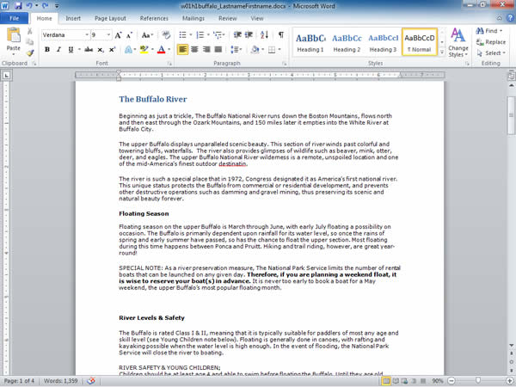
The Word Window
Quick Access Toolbar
Title bar
Rulers
Scroll bar
Status bar
View buttons
Zoom slider
6

